Slide 1
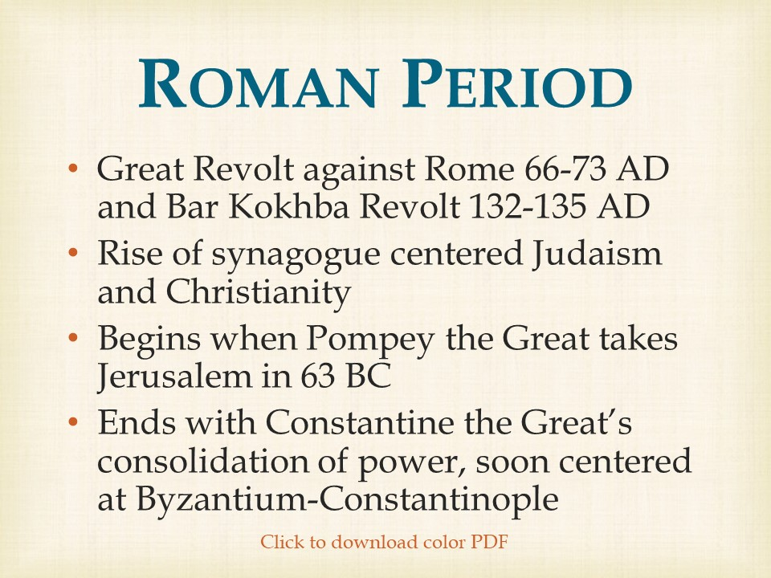

Slide 2
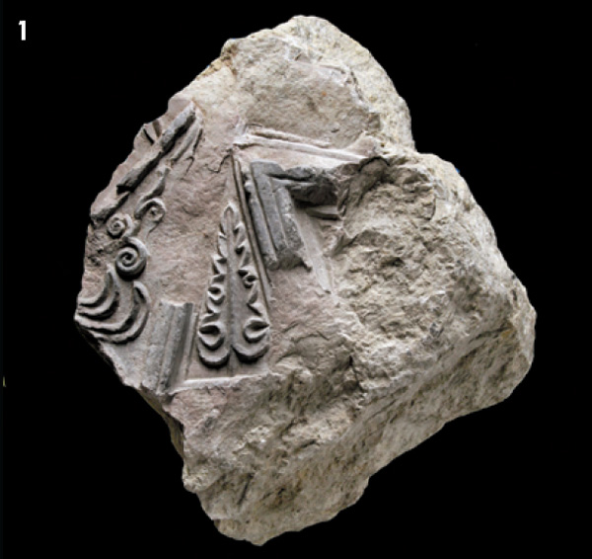
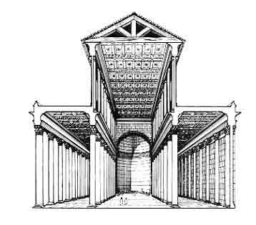
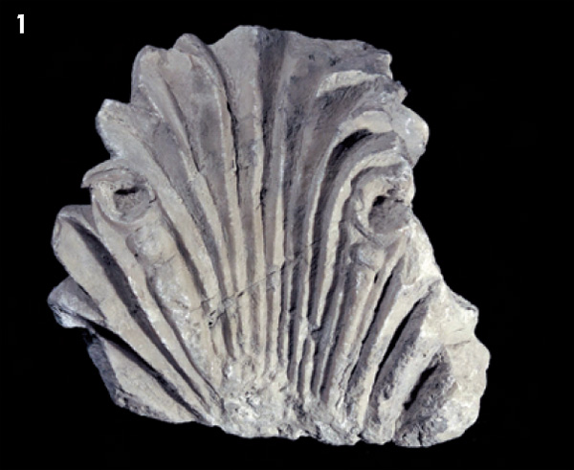
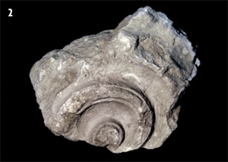
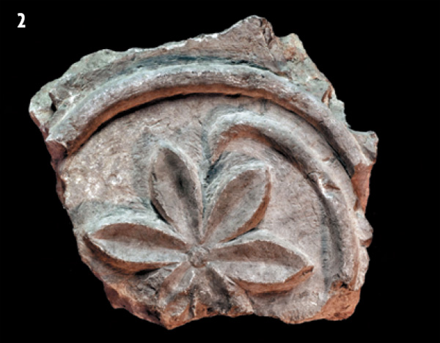
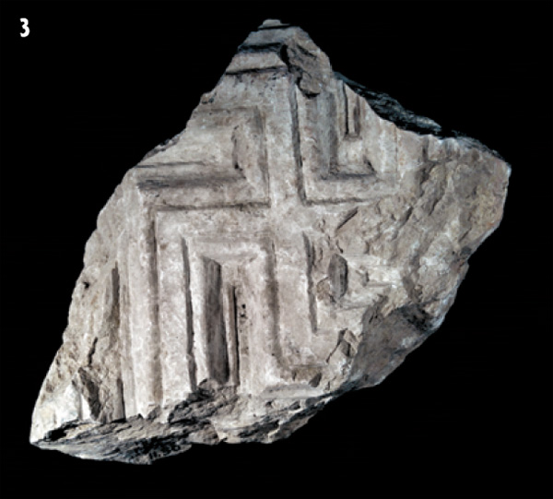
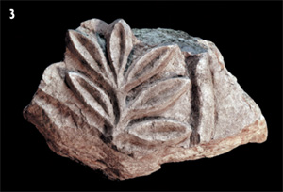
The Royal Stoa
Biblical Archaeology Review 15:6, November/December 1989
Reconstructing Herod’s Temple Mount in Jerusalem
Biblical Archaeology Review 36:2, March/April 2010
New Evidence of the Royal Stoa and Roman Flames

Slide 3
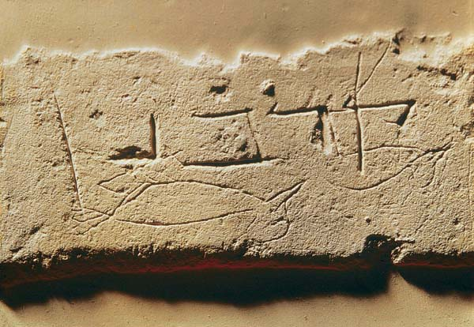
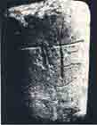
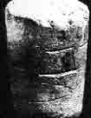
Korban Vessel
The bowl is inscribed with the Hebrew word korban (“sacrifice”) and is scratched with rough drawings of two dead (upside-down) birds. This bowl was doubtless intended for pilgrims to hold their sacrificial offering on their way to the Temple.
A fragment of a stone vessel, found in the fill near the southern wall
Biblical Archaeology Review 15:6, November/December 1989
Reconstructing Herod’s Temple Mount in Jerusalem
Biblical Archaeology Review 35:3, May/June 2009
This Place Is for the Birds

Slide 4
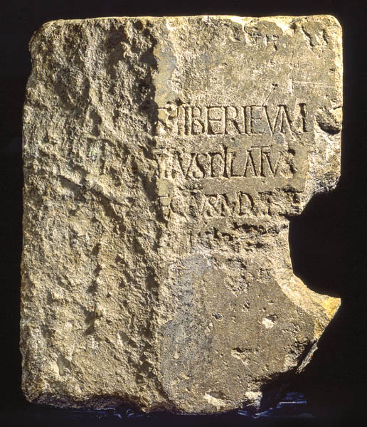
Pontius Pilate
The Pilate Stone presents Pontius Pilate as the Roman prefect of Judea. His dedication of a structure in honor of Tiberius fits with the picture of Pilate as a proponent of the Roman imperial cult in Judea. It may also demonstrate the governor’s personal reverence for the emperor, putting in a new light the words shouted at Pilate during Jesus’ trial: “If you release this man, you are no friend of the emperor” (John 19:12).
Biblical Archaeology Review 43:4, July/August 2017
Pontius Pilate
Notes:
‹#›

Slide 5
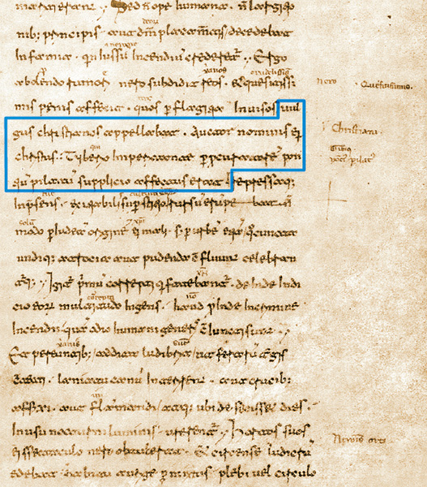
Tacitus Writes of The Christians
Book XV of Tacitus’s Annals is preserved in the 11th–12th-century Codex Mediceus II, a collection of medieval manuscripts now housed in the Biblioteca Medicea Laurenziana in Florence, Italy, along with other manuscripts and books that belonged to the Medici family. Highlighted above is the Latin text reading “… whom the crowd called ‘Chrestians.’ The founder of this name, Christ, had been executed in the reign of Tiberius by the procurator Pontius Pilate …”
Biblical Archaeology Review 41:1, January/February 2015
Did Jesus Exist? Searching for Evidence Beyond the Bible

Slide 6
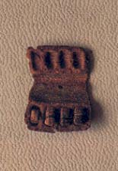
Qumran Phylactery
Phylactery (tefillin), found in a cave at Qumran with some of the Dead Sea Scrolls. Three of the original four scripture texts of this early first-century A.D. phylactery were found intact in their niches, thus affording unique evidence of the way the parchment slips had been folded and tied and of the material used for tying. The texts of these parchments were published by Yadin just one year after he acquired them in 1968.
Deuteronomy 6: 6, 8
“These commandments that I give you today are to be on your hearts... Tie them as symbols on your hands and bind them on your foreheads.”
Biblical Archaeology Review 10:5, September/October 1984
Yigael Yadin 1917–1984
Notes:
‹#›

Slide 7
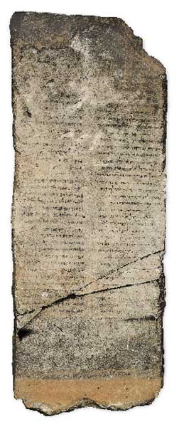
The Gabriel Stone 1st Century BC
In addition to the name Gabriel, the composition refers to the “messenger (or angel) Michael,” who is mentioned in Daniel 10:13, in the New Testament (Revelation 12:7 and Jude 9) and in extra-Biblical sources like Enoch and the Dead Sea Scroll known as the War Scroll (1QM). In these extra-Biblical sources Michael is frequently mentioned together with Gabriel. It is difficult to be more specific, but it does suggest that the text as a whole is apocalyptic (referring to the end of days), as these are clearly apocalyptic figures. We may conjecture that a rivalry between two messianic groups is involved. There seems to be no doubt that the composer of this text belongs to the group supporting the Davidic messiah.
Biblical Archaeology Review 34:1, January/February 2008
A New Dead Sea Scroll in Stone?

Slide 8
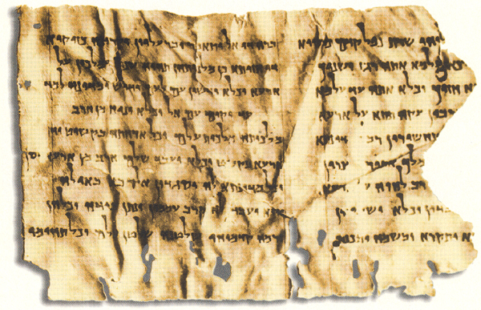
“Son of God” Text from the Dead Sea Scrolls
The ‘Son of God’ text, one of the Dead Sea Scroll fragments found in Qumran Cave 4, consists of two columns of nine lines each in the Aramaic language. We lack the beginnings of the lines in the first column, which has been damaged on the right (Aramaic, like Hebrew, is read from right to left). The second column ends in mid-sentence, so the document originally must have possessed at least a third column.
This text, dated to the late first century B.C.E., has extraordinary parallels to the annunciation scene in the Gospel of Luke (Luke 1:31–35), including use of the titles “Son of God” and “Son of the Most High,” the earliest known references to these terms in a messianic context. These parallels strongly suggest a relationship between this Qumran text and the later Gospel text, if not a direct dependence, then a dependence on a common tradition.
Bible Review 9:3, June 1993
A Pre-Christian “Son of God” Among the Dead Sea Scrolls

Slide 9
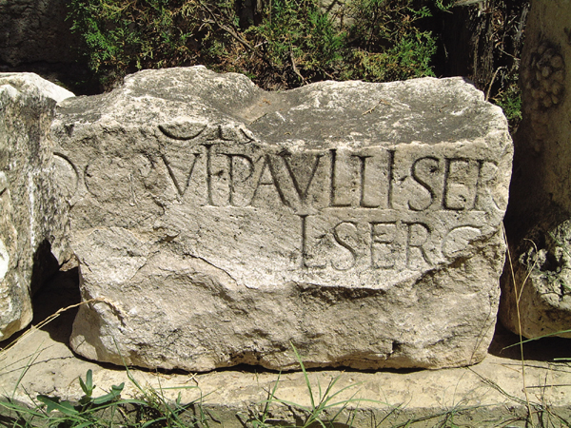
Paul’s First Convert on Cyprus
Paul’s first convert on Cyprus. The name of the Roman governor of Cyprus, Sergius Paulus, and his title, proconsul, were found inscribed on this stone near Paphos in Cyprus, where, according to Acts 13:7, Paul converted him to Christianity during his first missionary visit. The name is also attested on a second stone found in Rome (not shown), where the governor apparently returned when his term had expired.
Biblical Archaeology Review 28:6, November/December 2002
The Short List: The New Testament Figures Known to History

Slide 10
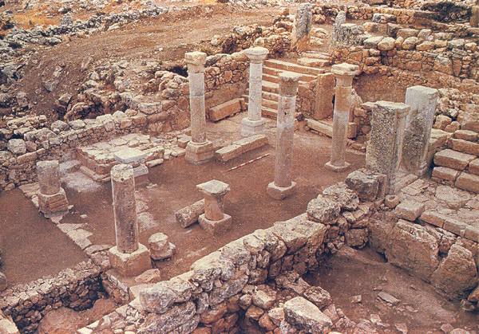
The Rise of Synagogues
Ancient synagogues were designed using three basic architectural plans. The Khirbet Shema synagogue , in the northern Galilee, is a broadhouse-type synagogue: Its entrance lies along the wall oriented toward Jerusalem, on the right side of the photo;
inside the synagogue, along the wall opposite the entrance, the excavators found a well-constructed bemah—a raised place where the Torah shrine was set. In the so-called “Galilean Basilica” (as in the Bar’am synagogue), three large portals adorn a facade oriented southward toward Jerusalem; the Torah shrine was probably between the doors on the southern wall.
Bible Review 12:2, April 1996
Did the Synagogue Replace the Temple?

Slide 11
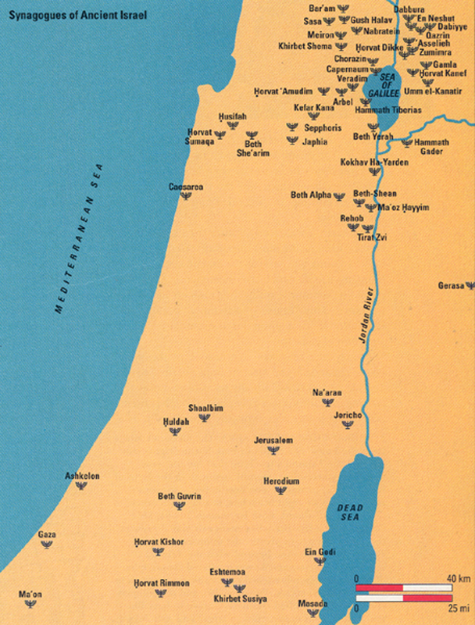
Map of Synagogues in Ancient Israel from 1st – 8th Century AD
Bible Review 12:2, April 1996
Did the Synagogue Replace the Temple?

Slide 12
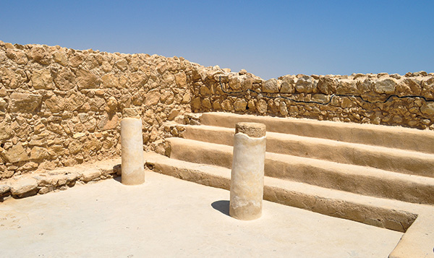
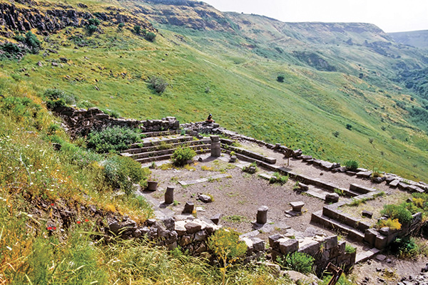
Masada and Gamla Synagogues
Like the assembly structure at Masada—converted into a synagogue by the Zealots during the First Jewish Revolt—stepped benches lined the walls of Second Temple-period synagogues, and the focal point was the center of the room.
The Second Temple-period synagogue at Gamla features stepped benches along its walls and a mikveh (ritual bath) located just south of its entrance.
Biblical Archaeology Review 41:3, May/June 2015
Synagogues: Before and After the Roman Destruction of the Temple
Notes:
‹#›

Slide 13
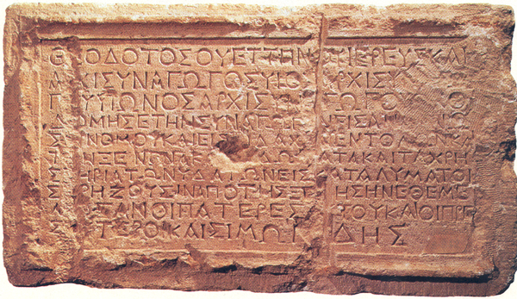
Theodotus Synagogue Inscription 1st Century AD
Bible Review 12:2, April 1996
Did the Synagogue Replace the Temple?
“Theodotus built the synagogue for the reading of the law [Torah]” reads part of this first-century C.E. inscription, in Greek, discovered just south of the Temple Mount in Jerusalem. According to the inscription, Theodotus’s synagogue contained rooms for itinerants and water installations for bathing. Standing in sight of the Temple Mount, this Jerusalem synagogue was a place where Jews assembled to study Scripture. Theodotus’s synagogue apparently also gave shelter to pilgrims, who may have purified themselves in its pools before ascending to the Temple.

Slide 14
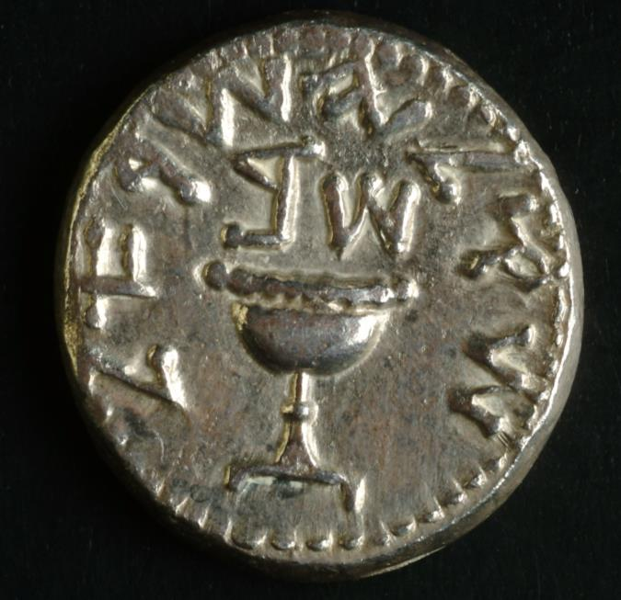
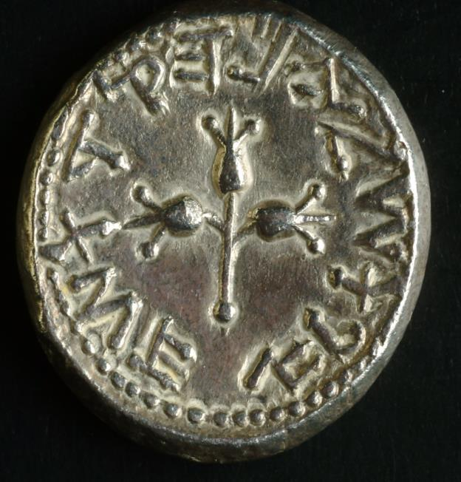
“Shekel of Israel,” “Jerusalem the Holy” and “Year Two” (the second year of the Revolt, 68 C.E.)
Biblical Archaeology Review 29:3, May/June 2003
Spending Your Way through Jewish History
Notes:
‹#›

Slide 15
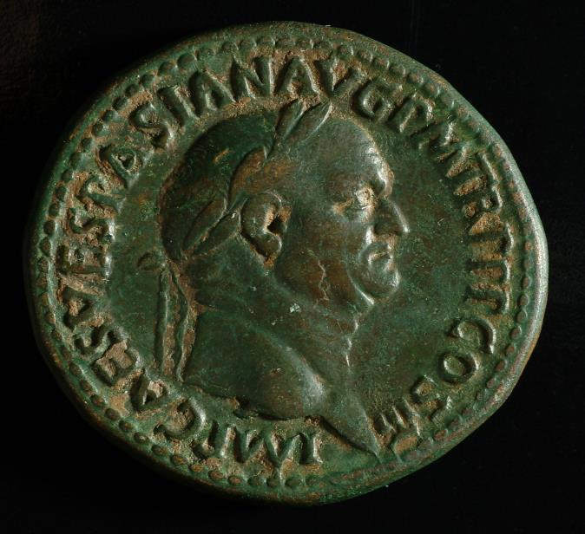
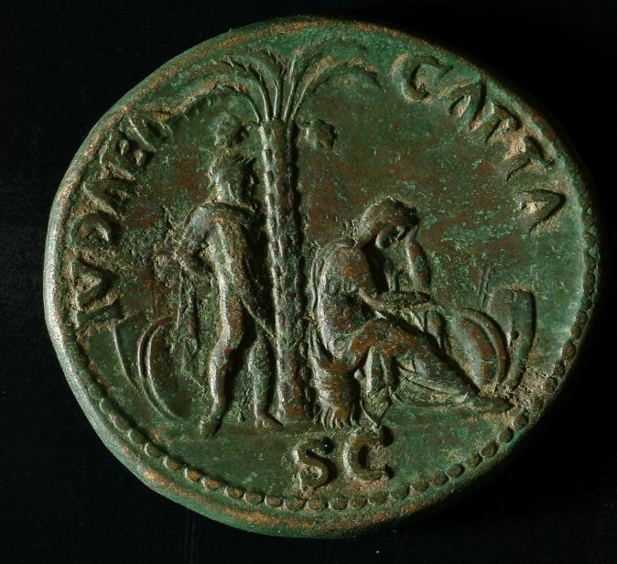
Judea Capta Coin
Despite its minute size within the empire, suppression of the Great Jewish Revolt of 66–70 C.E. required a massive Roman military force.
Biblical Archaeology Review 36:1, January/February 2010
Roman Coins Boast “Judaea Capta”
Notes:
‹#›

Slide 16
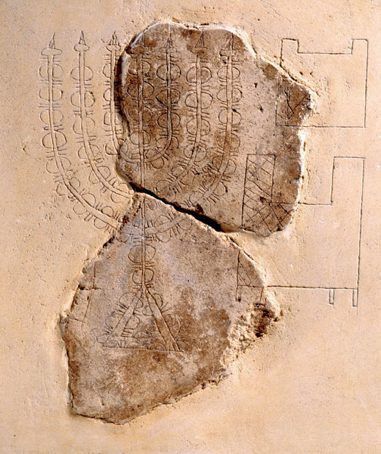
The Best Representation of the Temple Menorah
The Temple Menorah appears in the fragment of a first-century graffito etched in plaster found in excavations in Jerusalem’s Jewish Quarter merely a few hundred feet from the Temple Mount. It is one of the earliest depictions of the candelabra that illuminated the Jewish Temple. The seven-branched Menorah rests on a triangular base, unlike its depiction on the Arch of Titus. The incomplete etchings to the right (here reconstructed) are usually interpreted as being part of the Showbread table and the altar. The juxtaposition of the Menorah and the table mirrors their description in Exodus 25, and is likely based on their relationship to one another in the Temple. The graffito was probably carved by someone familiar with the items, but for reasons unknown.
Biblical Archaeology Review 31:4, July/August 2005
The Temple Menorah—Where Is It?
Notes:
‹#›

Slide 17
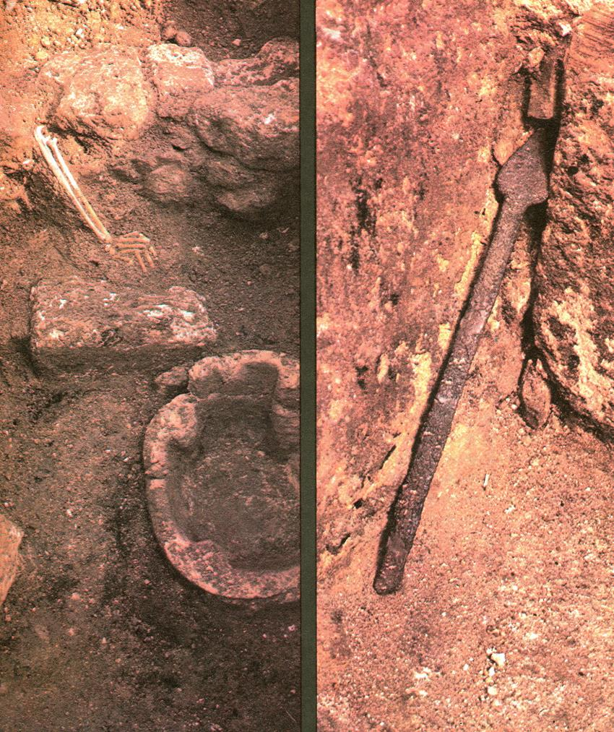
Jerusalem and the Temple Are Destroyed by Titus
(left) Caught in the fire when the Romans attacked, a young woman who was in the kitchen of the Burnt House sank to the floor and was reaching for a step near the doorway when she died. The fire had spread so fast, perhaps fed by oil used in this kitchen, that she could not escape and was buried by falling debris.
(right) At the ready, this spear was propped against a wall in the Burnt House where its owner could quickly grab it to defend himself against the invading Romans. But the Romans burned this house so quickly that the spear was never touched; instead it was buried in place by the fiery debris of collapsed walls and ceiling, preserving for 2,000 years this image of resistance and tragedy.
Biblical Archaeology Review 9:6, November/December 1983
Jerusalem in Flames—The Burnt House Captures a Moment in Time
Notes:
‹#›

Slide 18
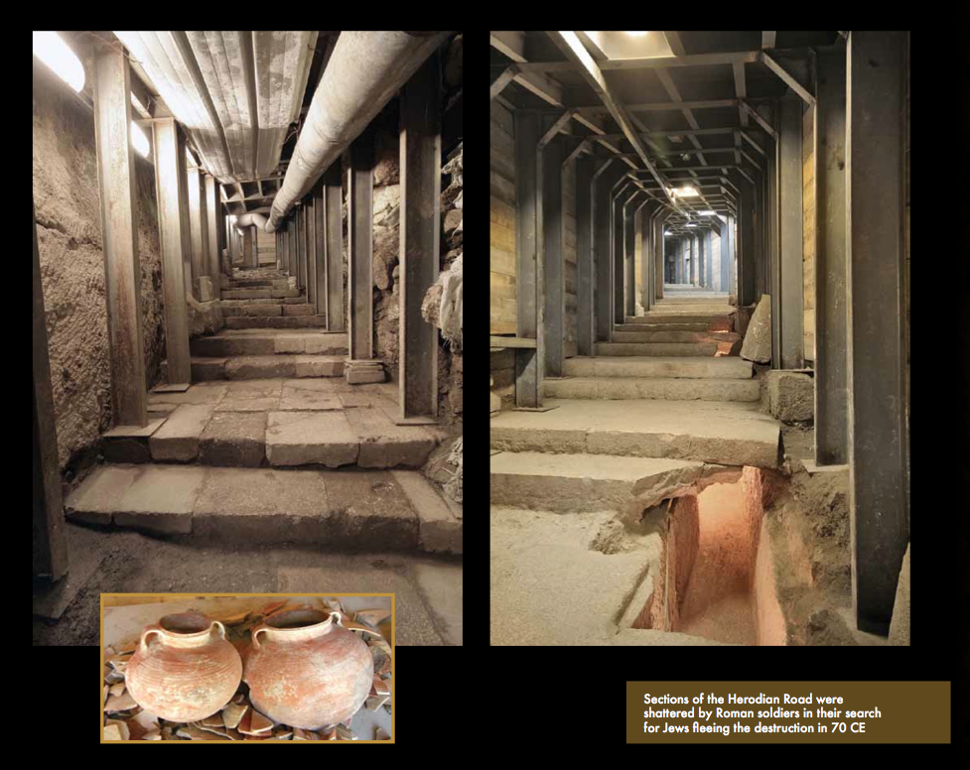
Underground Tunnels Found Beneath the City of David
These wide Herodian paving stones not only created a stepped street from Jerusalem’s Pool of Siloam up to the Temple Mount, but they also concealed a large drainage tunnel that ran beneath the street. Breaches in the pavement make it possible to see into this tunnel, where the inhabitants of Jerusalem may have tried to escape the city during the Roman conquest and destruction in 70 C.E.
Biblical Archaeology Review 36:3, May/June 2010
Escape Clause

Slide 19
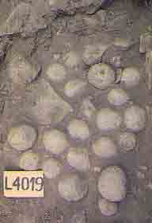
Ballista Stones From Gamla
Spherical basalt stones provided the ammunition for Roman ballistae, a type of catapult. The ballista stones shown here were found in a heap inside the city wall. Gamla’s defenders probably collected them during the night in order to throw them back at the Romans the next day.
Biblical Archaeology Review 18:1, January/February 1992
Gamla: Portrait of a Rebellion

Slide 20
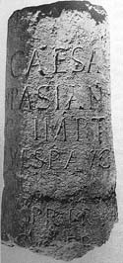
Column Fragment Inscribed with the Names of Vespasian and Titus
“IMP[ERATOR] CAESAR VESPASIANUS AUG[USTUS] … ” reads the beginning of the Latin inscription on a triumphal column dedicated to Emperor Titus (ruled 79–81 C.E.; his family name was Vespasian), who led the siege against Jerusalem nine years before acceding to the throne. The abbreviation “LEG•X•FRE” appears at the bottom, indicating the column was erected by the Tenth Roman Legion. The monument probably stood at one of the entrances to the Roman temple in Jerusalem. The column was discovered incorporated into the foundations of a Moslem palace south of the Temple Mount.
Biblical Archaeology Review 23:6, November/December 1997
Searching for Roman Jerusalem

Slide 21
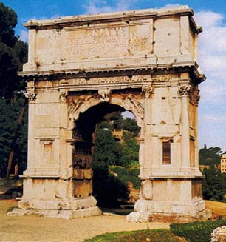
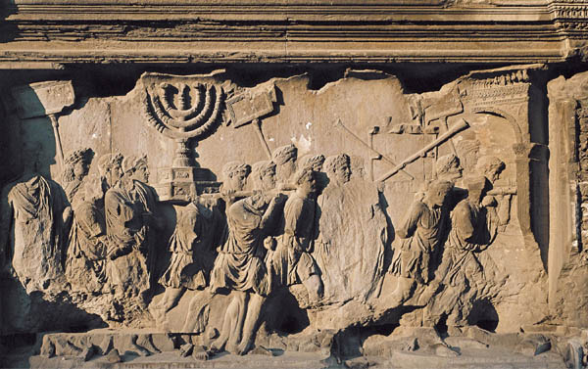
Arch of Titus
Titus’s triumphal return from a vanquished Jerusalem in 70 C.E. was commemorated on his arch, not far from the Colosseum. Along the inside panel, just visible in the photograph of the arch , victorious soldiers display the items captured from the Temple, including the sacred candelabrum (menorah) and other ritual artifacts
Biblical Archaeology Review 27:4, July/August 2001
Financing the Colosseum
Biblical Archaeology Review 43:3, May/June 2017
True Colors
Notes:
‹#›

Slide 22
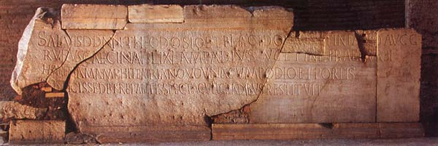
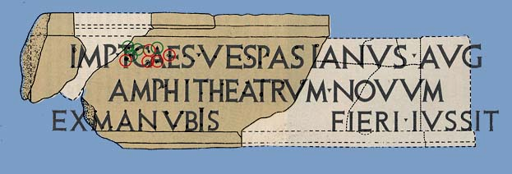
The Colosseum Inscription
The Colosseum Inscription
A dedication attributing the construction of the Colosseum to Titus but still explaining that it was done ex manubiis, with the proceeds from the spoils of war.
Biblical Archaeology Review 27:4, July/August 2001
Financing the Colosseum
Notes:
‹#›

Slide 23
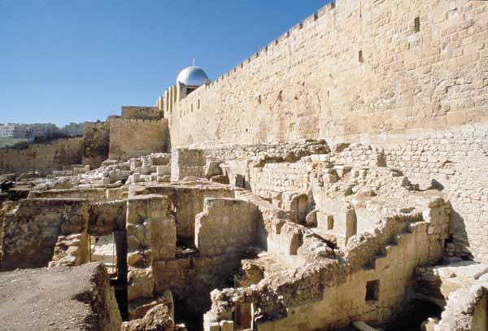
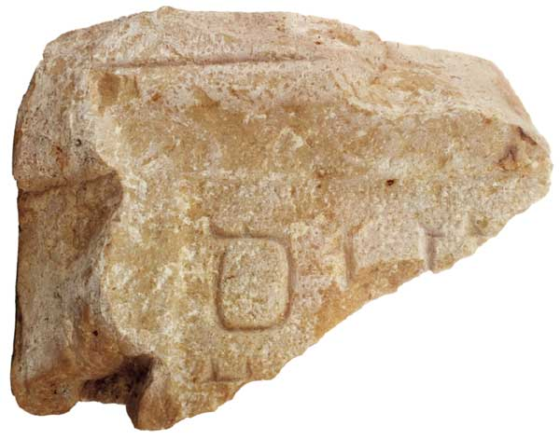
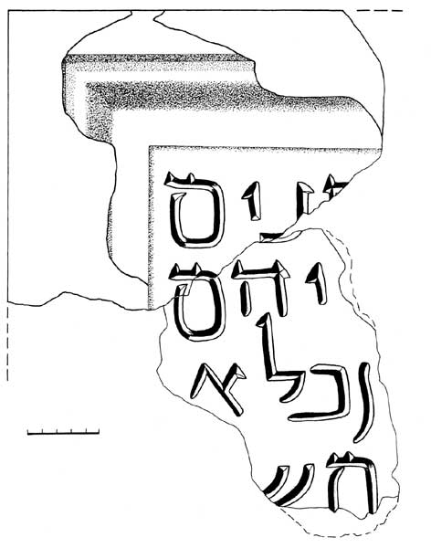
The Sanhedrin
Here then were the remains of a large Herodian building adjacent to the southern wall of the Temple Mount (at the foot of and east of a major entrance, the Triple Gate), at the most prominent point in the city, where masses of Jewish pilgrims once gathered to enter the Temple compound.
Found nearby was an inscription fragment (seen here) with part of the word “elders,” which matched another fragment found in the 19th century.
Biblical Archaeology Review 30:3, May/June 2004
Temple Mount Excavations Unearth the Monastery of the Virgins

Slide 24
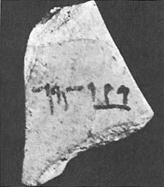
The Siege of Masada
One of 11 ostraca containing single names, this sherd bears in Aramaic script the name ben Ya’ir, undoubtedly Eleazar ben Ya’ir, leader of Masada’s defenders. The historian Josephus relates that when defense against the Romans seemed hopeless the men at Masada cast lots to decide the order in which they and their families would commit suicide. This ostracon is probably the lot cast by Masada’s commander.
Biblical Archaeology Review 5:3, May/June 1979
The Evolution of Two Hebrew Scripts
Notes:
‹#›

Slide 25
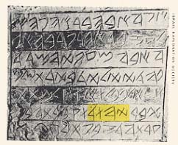
Abba Inscription
The Abba inscription demonstrates that yhwd, an Aramaic spelling for Judah introduced in the Persian period (538–332 B.C.), can appear in the paleo-Hebrew script, even though paleo-Hebrew script, when used, was ordinarily used for the Hebrew language. The tint highlights the name yhwd in the sixth line. Found engraved on the wall of a burial chamber in a tomb in the Giv‘at Ha-Mivtar area of Jerusalem, the inscription dates to the Herodian period (37 B.C.–70 A.D.).
“I, Abba, son of the priest
Eleaz(ar), son of Aaron the high (priest), I
Abba, the oppressed and persecuted,
who was born in Jerusalem, and went to exile into Babylonia and brought (back to Jerusalem) Mattathi(ah),
son of Jud(ah), and I buried him in the
cave, which I acquired by the writ.”
Biblical Archaeology Review 19:4, July/August 1993
The Bat Creek Inscription: Did Judean Refugees Escape to Tennessee?

Slide 26
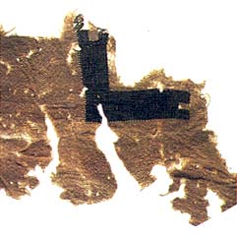
Prayer Shawl Fragment Found at Masada
Numbers 15:38
“Throughout the generations to come you are to make tassels on the corners of your garments, with a blue cord on each tassel.”
A white wool mantle marked with the Greek letter gamma, a motif used on men’s prayer shawls, or tallit, is among the 2,000 textiles found at Masada.
Biblical Archaeology Review 23:1, January/February 1997
Masada—The Final Reports

Slide 27
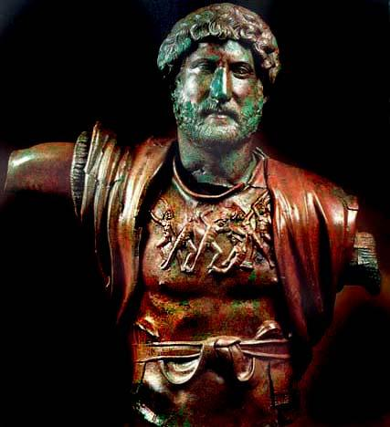
Hadrian Roman Emperor, 117 - 138 AD
Vigorous, muscular and armorclad, Emperor Hadrian—in the rare bronze sculpture featured on the cover of this issue—appears as the adept military leader who dominated the Mediterranean world from 117 to 138 C.E. His commanding appearance is recognizable from marble statues, reliefs, coins and even ancient texts.
Biblical Archaeology Review 23:6, November/December 1997
Roman Jerusalem
Hadrian: A Portrait in Bronze
An American tourist named Morton Leventhal discovered the statue in 1975, while searching for coins on the ancient mound of Tel Shalem, in the Jordan River Valley.
Notes:
‹#›

Slide 28
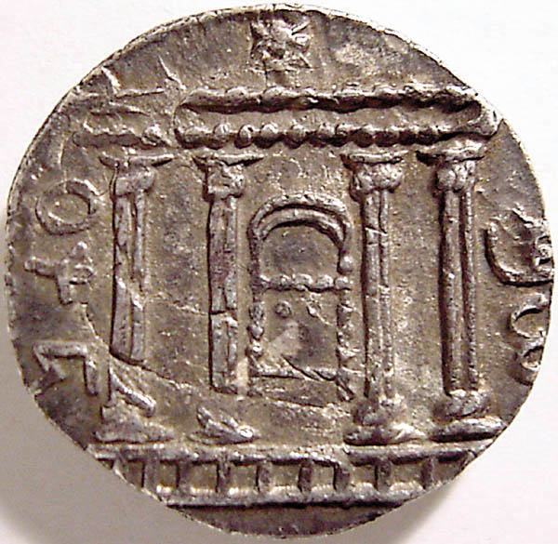
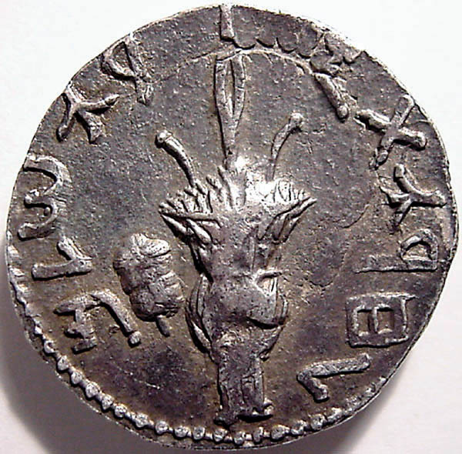
The Bar Kokhba Revolt
Sixty-two years after the destruction of the Jerusalem Temple, Shimon Bar-Kokhba (or Kosiba, as we know from contemporaneous inscriptions) led the Second Jewish Revolt against Rome (often called the Bar-Kokhba Revolt). The new revolutionary government, like the one that had seized power two generations before, immediately minted silver coinage.
Biblical Archaeology Review 29:3, May/June 2003
Spending Your Way through Jewish History
Notes:
‹#›

Slide 29
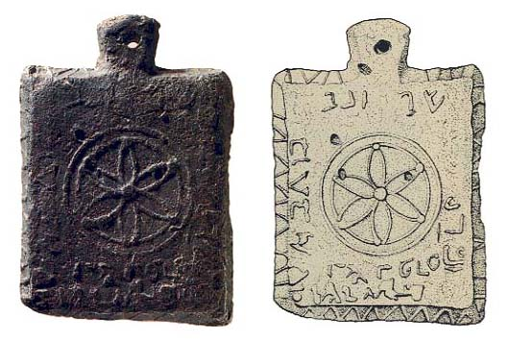
Lead Weight From Bar Kokhba Revolt Against Rome 132-135 AD
This lead weight was found in an underground tunnel used as a hiding place by Jewish defenders. It is inscribed: “Simeon ben Kosba president (or head of state) of Israel and his economic chief. Peras.”
Biblical Archaeology Review 14:4, July/August 1988
Name of Ancient Israel’s Last President Discovered on Lead Weight
Actual size: 3 1/2 by 2 2/3 inches and 1/3 inch thick. Small as it is, the lead tablet weighs almost two pounds.

Slide 30
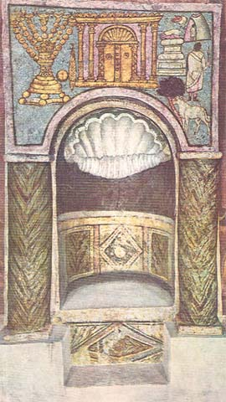
Painting of Dura Europos Synagogue
The Torah shrine of Dura Europos. A shell decorates the roof of the niche. Above the niche is a painting of a two-doored ark, also surmounted with a shell. On the left is a lulav and etrog, and a three-footed menorah. On the right is an unusual portrayal of the binding of Isaac. The figures all have their backs to us; their heads are black blots. A ram stands under a tree, waiang to be substituted for Isaac. Above the ram is Abraham in a white robe holding an upraised knife; only his buttock is outlined. To the left is the child Isaac on the altar. At the top is another figure, back turned to us, inside a tent. Is this Sarah waiting below, Abraham’s servant, or another picture of Abraham himself? To the left of the tent is the hand of God telling Abraham to lay not his hand on his son.
Biblical Archaeology Review 6:4, July/August 1980
Books in Brief
Biblical Archaeology Review 42:1, January/February 2016
A Temple’s Golden Anniversary

Slide 31
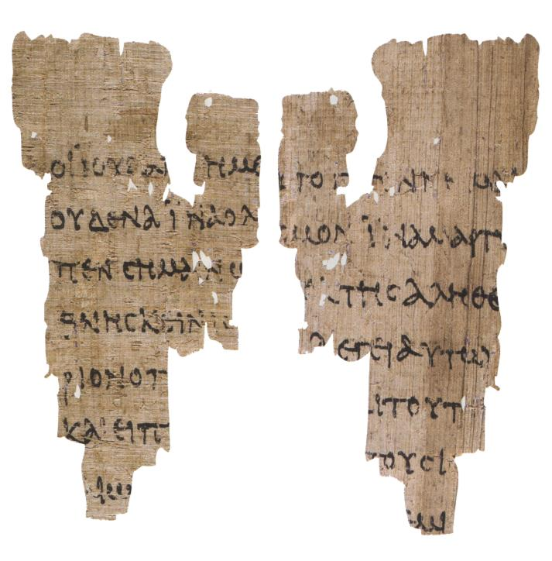
Oldest Gospel
The oldest gospels. Dating to about 140 A.D., this tiny fragment from the Gospel of John (both sides, shown here) and five fragments from the noncanonical Egerton Gospel (one leaf is shown in the previous photo) are two of the three oldest extant Christian texts. (The third is the fragmentary Coptic Gospel of Thomas, not shown.)
Measuring only 3.4-inches tall, the canonical fragment above includes Greek text from John 18:31–33 (left) and 18:37–38 (right), in which Pilate is questioning Jesus.
Bible Review 18:3, June 2002
The 34 Gospels
Notes:
‹#›

Slide 32
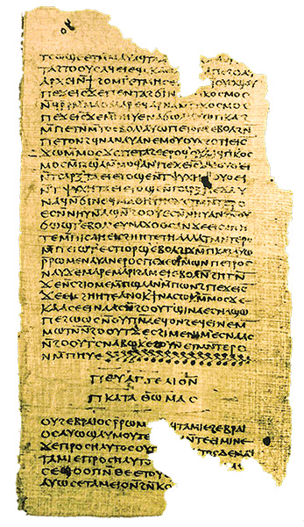
The Gospel of Thomas
“THE GOSPEL ACCORDING TO THOMAS” appears in larger letters and indented at the end of a complete Coptic translation of 114 sayings of Jesus found near Nag Hammadi. In this period it was more common to write titles at the end than at the beginning. The Nag Hammadi Library now resides at the Coptic Museum in Cairo, Egypt.
Biblical Archaeology Review 41:4, July/August 2015
The Gospel of Thomas: Jesus Said What?

